Slide 1

Component Driven Development with React
Alberto Villar (Vilva.)

Slide 2


?

Slide 3
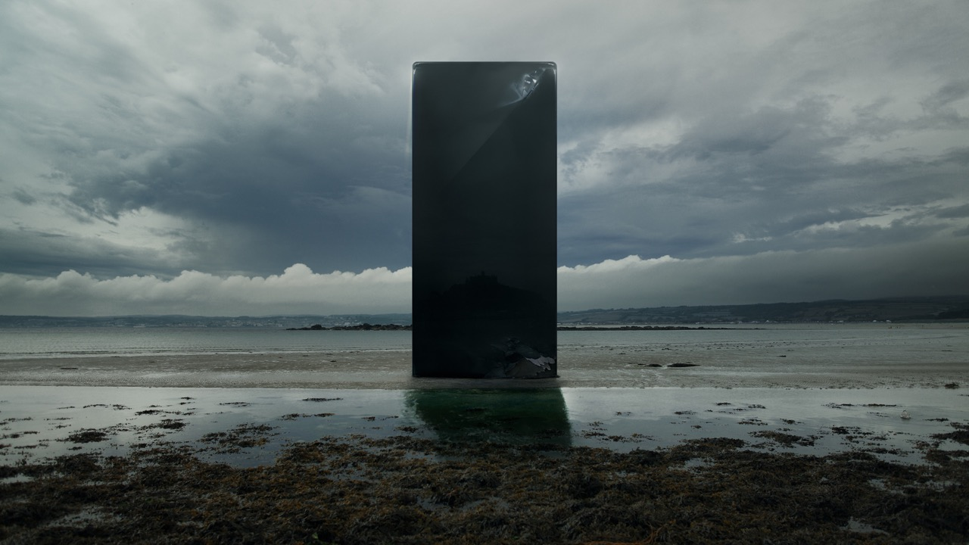
MONOLITH

Slide 4
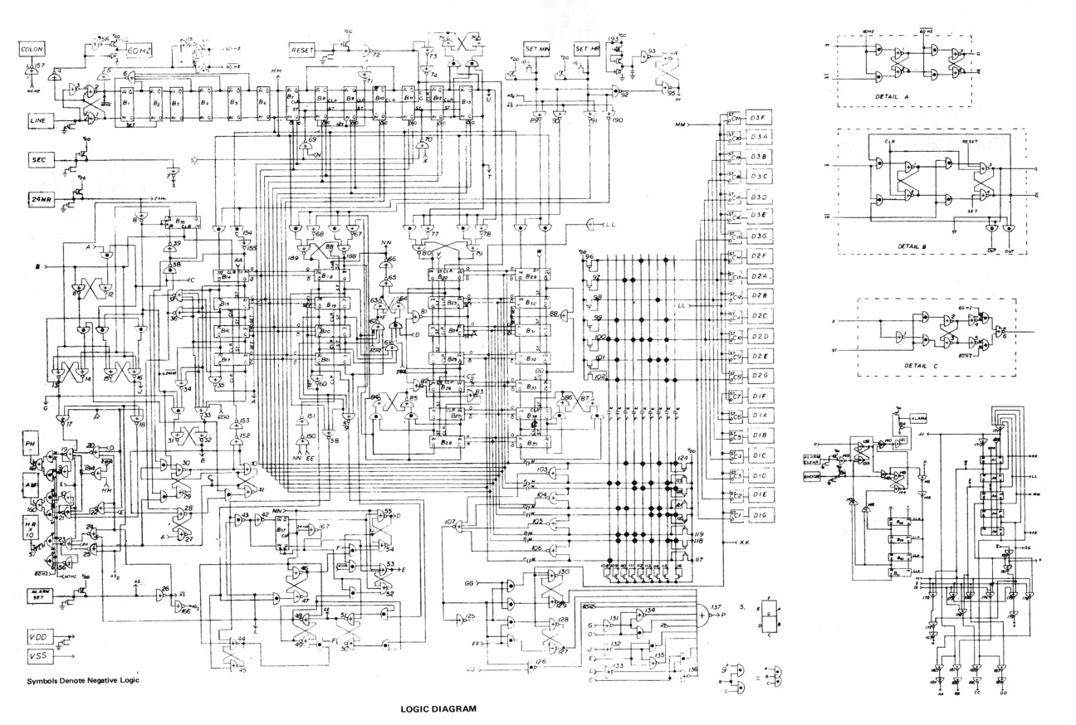

Slide 5
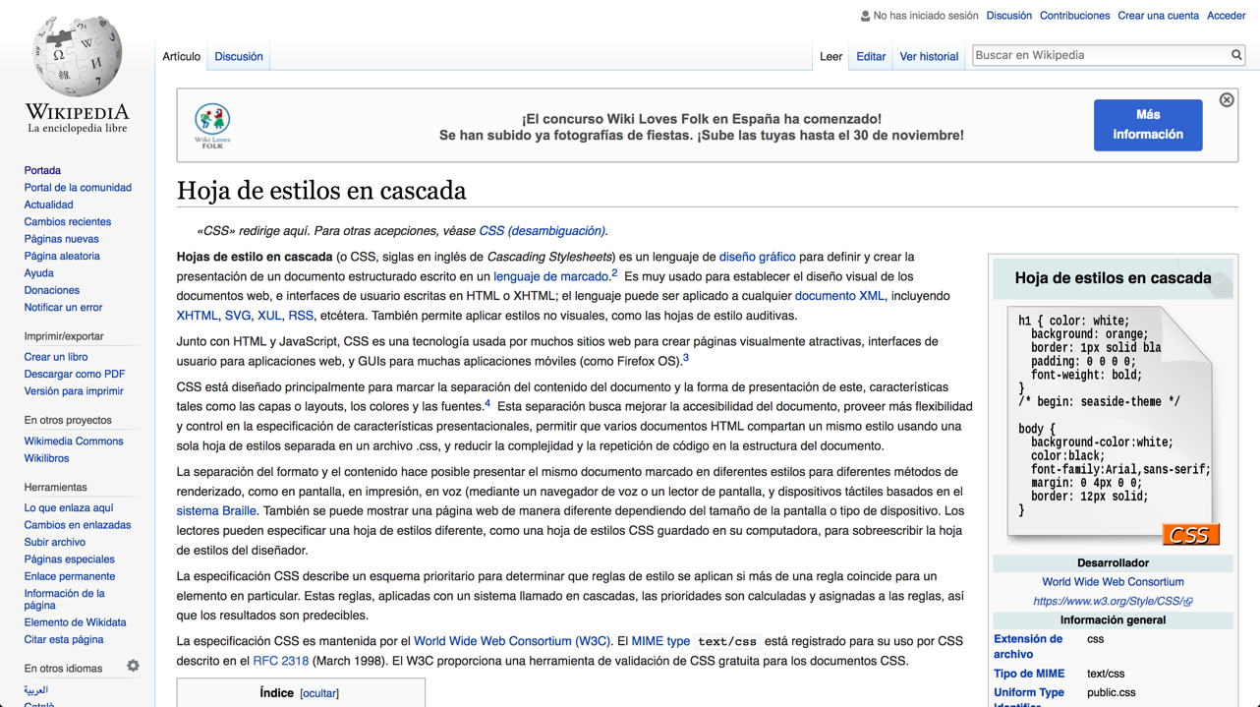

Slide 6
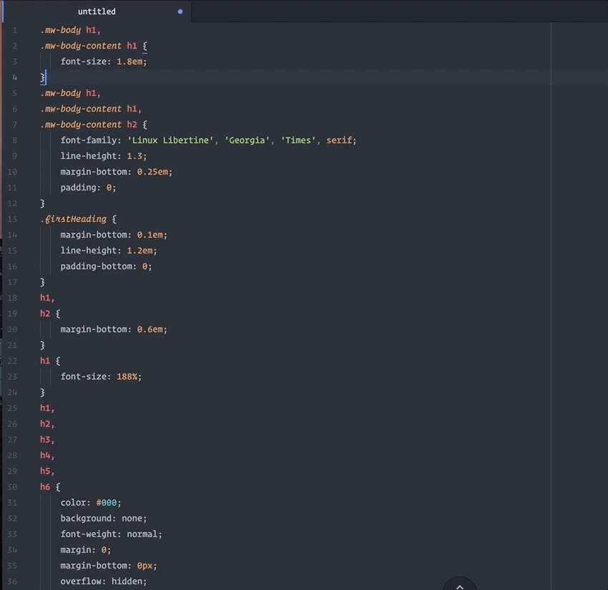

Slide 7
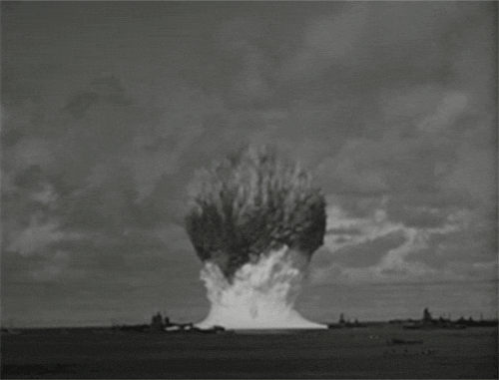

Slide 8
COMPONENTS

Slide 9
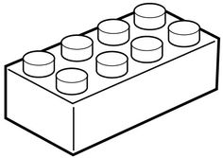
IN
OUT
INDEPENDENT
ENCAPSULATED

Slide 10

PROPS
STATE?
RENDER

Slide 11
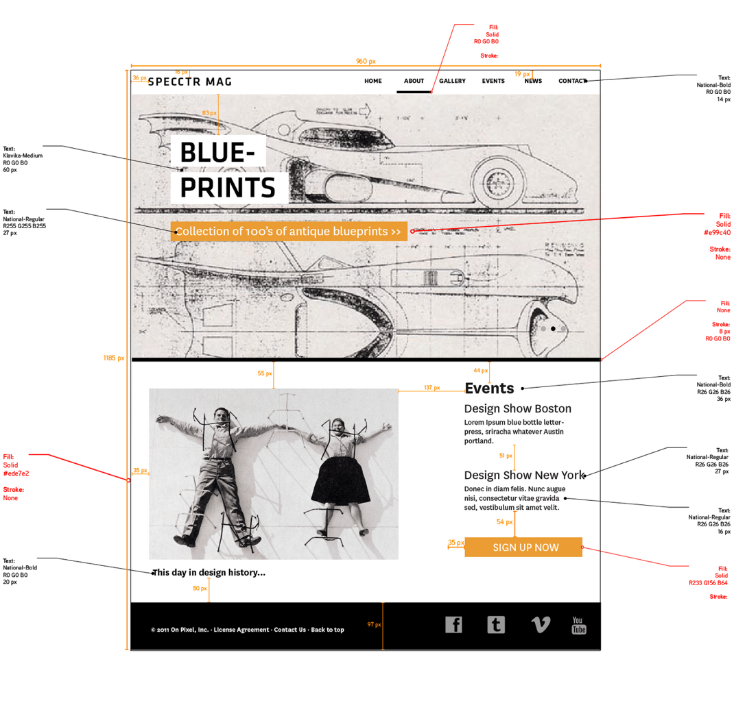

Slide 13
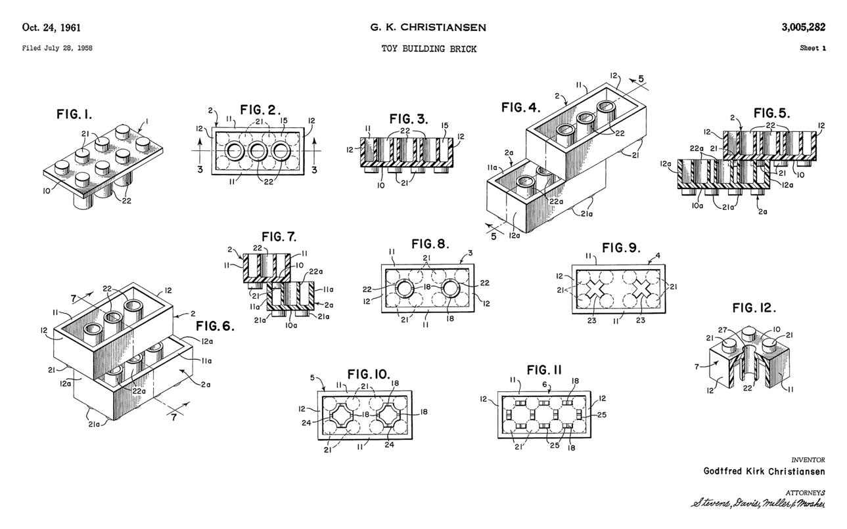

Slide 14
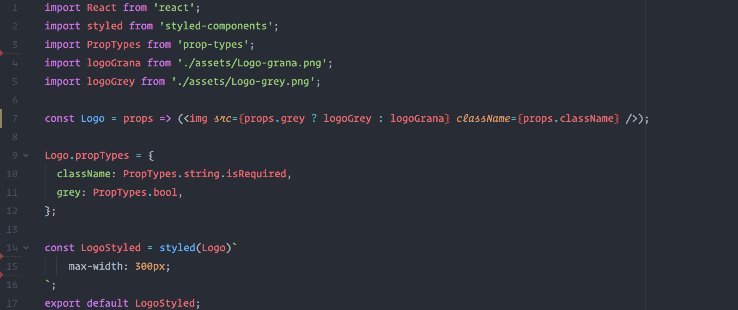
http://bit.ly/JVStyled

Slide 15
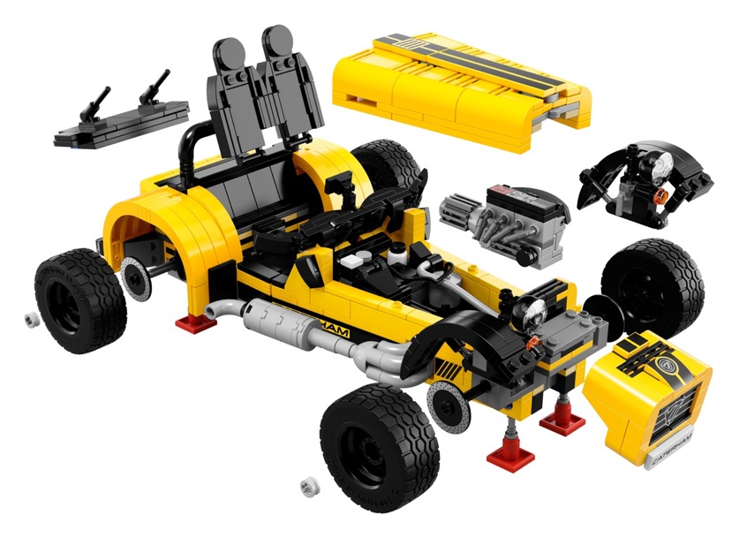
x2

Slide 16
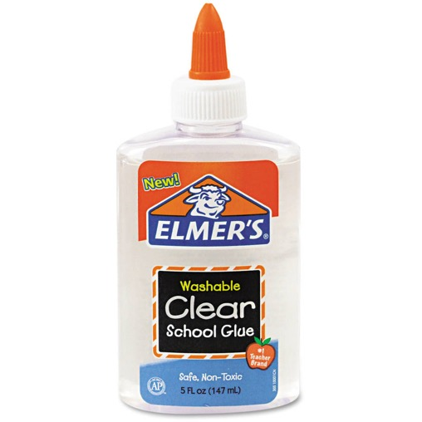
THE GLUE
HOC
Markup
Prop Chaining

Slide 17
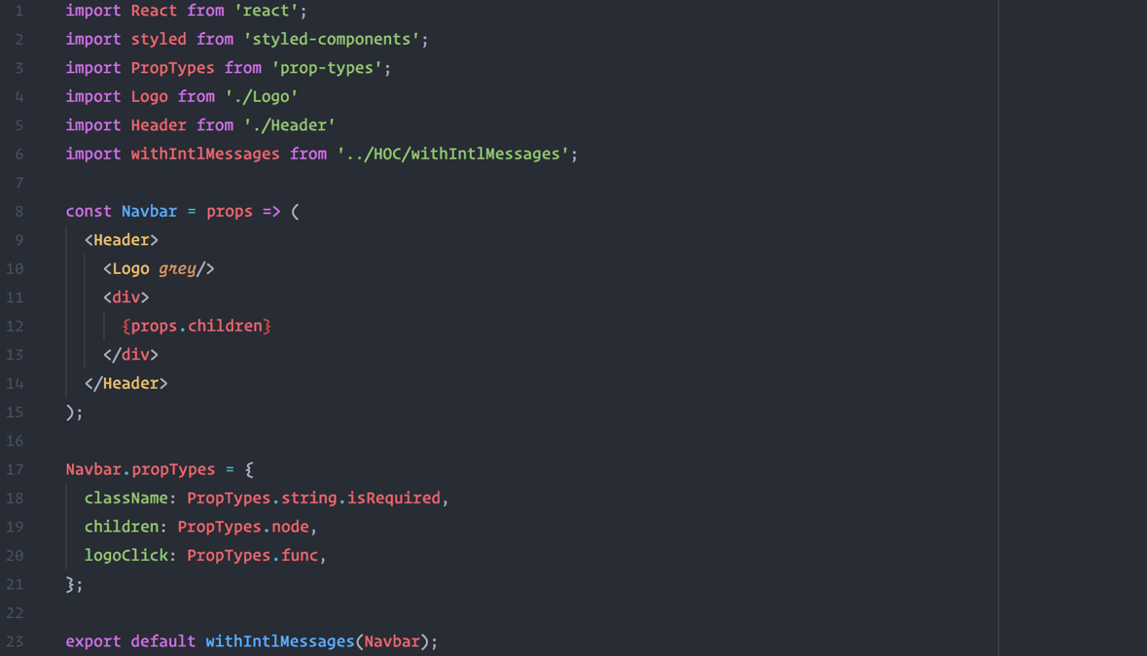

Slide 18
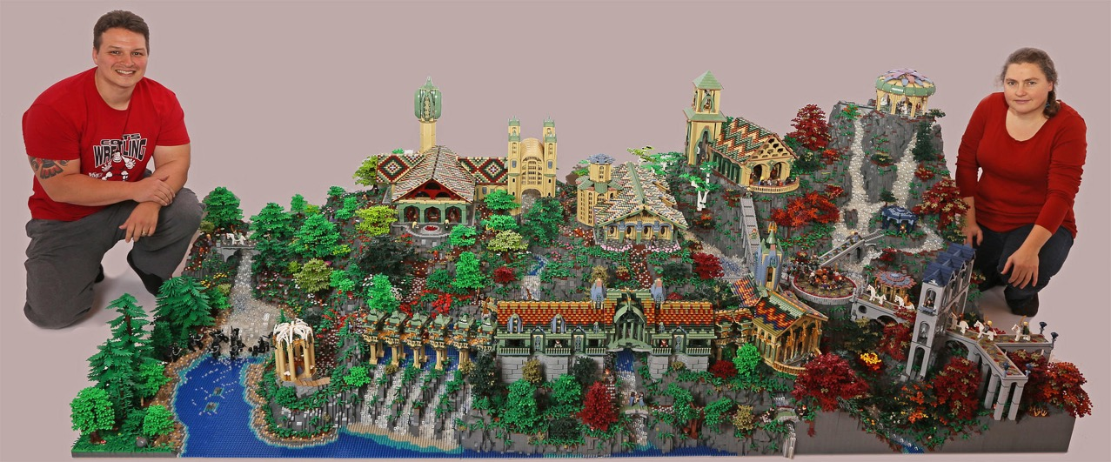
I love components so much

Slide 19
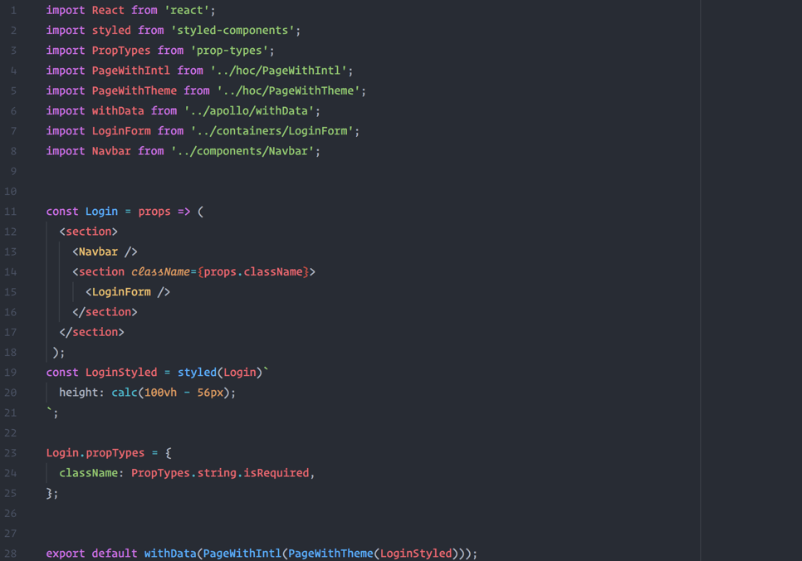

Slide 20
MONOLITH
COMPONENTS
Permeable
Dependant
Dif. to share
Dif. to test
Dif. to maintain
Heavy
Encapsulated
Independent
Easier to share
Easier to test
Easier to maintain
DRY & Lightweight

Slide 21
VDD

Slide 22
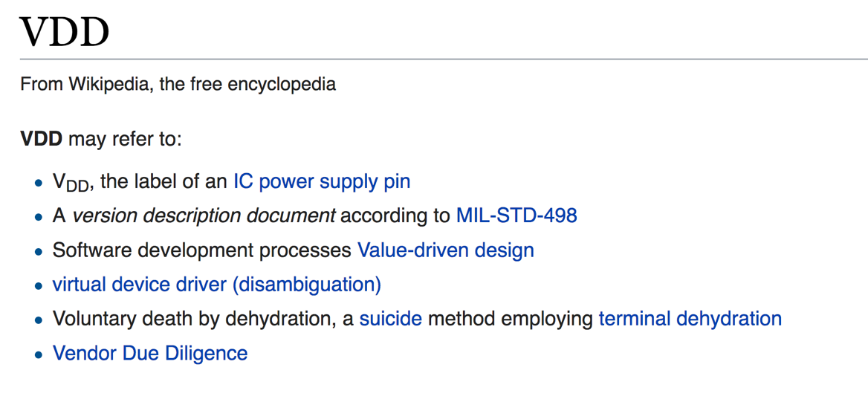

Slide 23
Notes:
Pause…..

Slide 24


Slide 25
Visual Driven Development

Slide 26
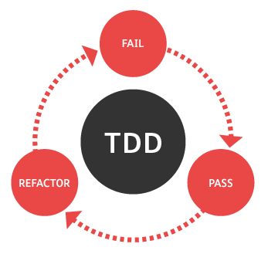

Slide 27

HA! HA!
IT FAILS
VDD

Slide 28
Ingredients
1 x A human being
1 x A way to make encapsulated code (React!)
1 x A spec (Component Design)
1 x Indendent development enviroment (Component explorer)

Slide 29
Component Explorers
(Style guides?)

Slide 30
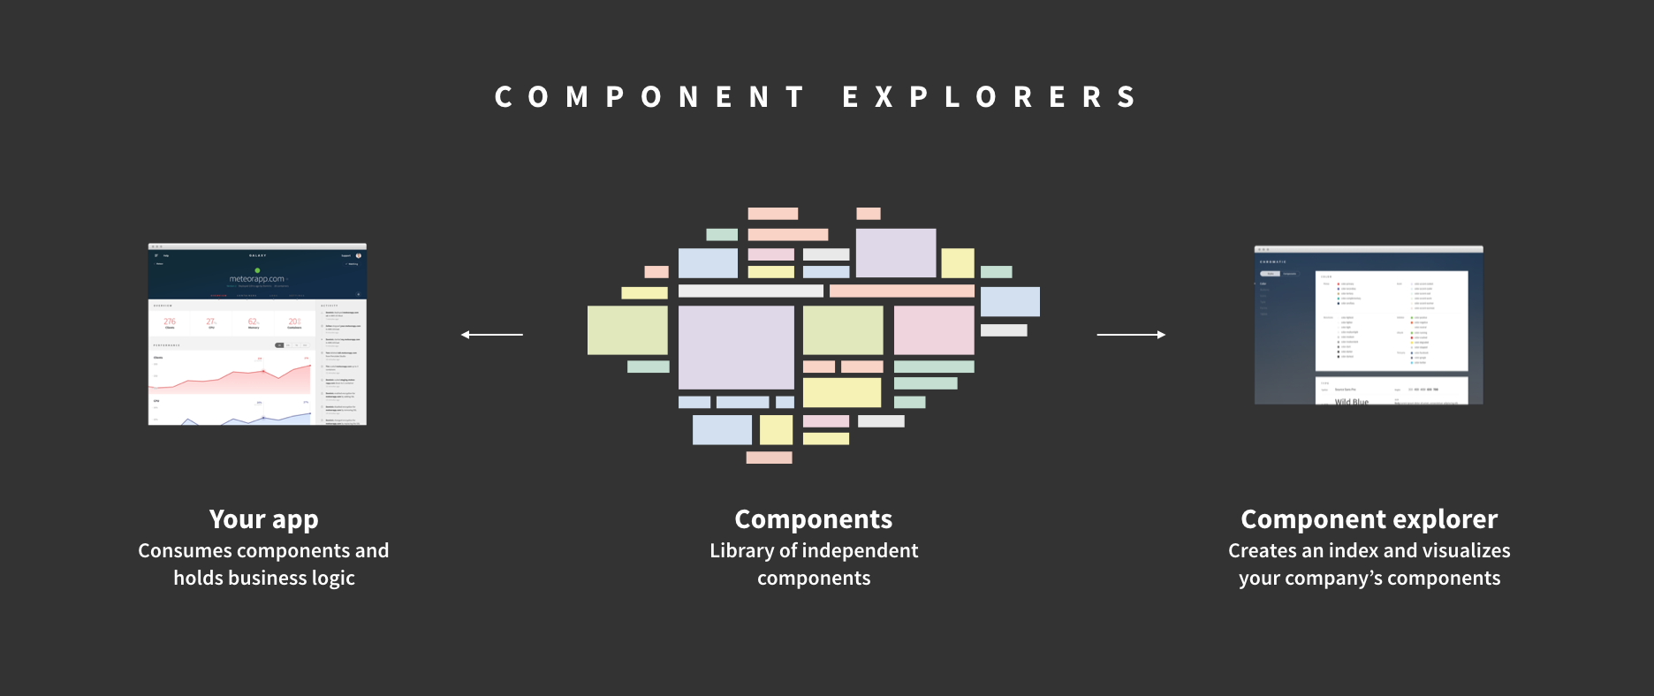
Image by: Chroma - https://blog.hichroma.com
Notes:
GO FUCKING READ THIS BLOG. They know their shit way better than me
You see this heart? This means I love this guys.

Slide 31



Slide 32
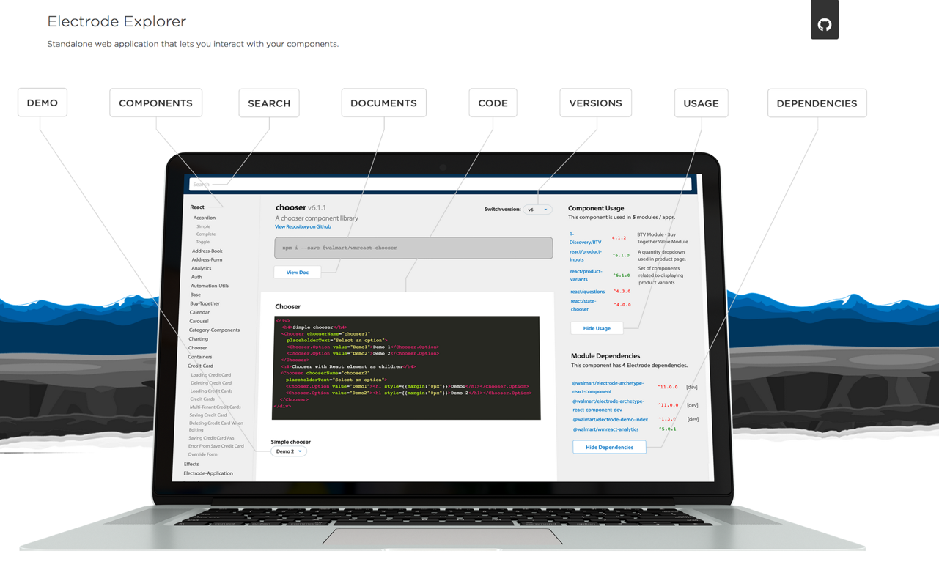

Slide 33


Slide 34
Notes:
This guys put this on their front page. Its LOVE! This is some serious shit, you don’t play with love…

Slide 35
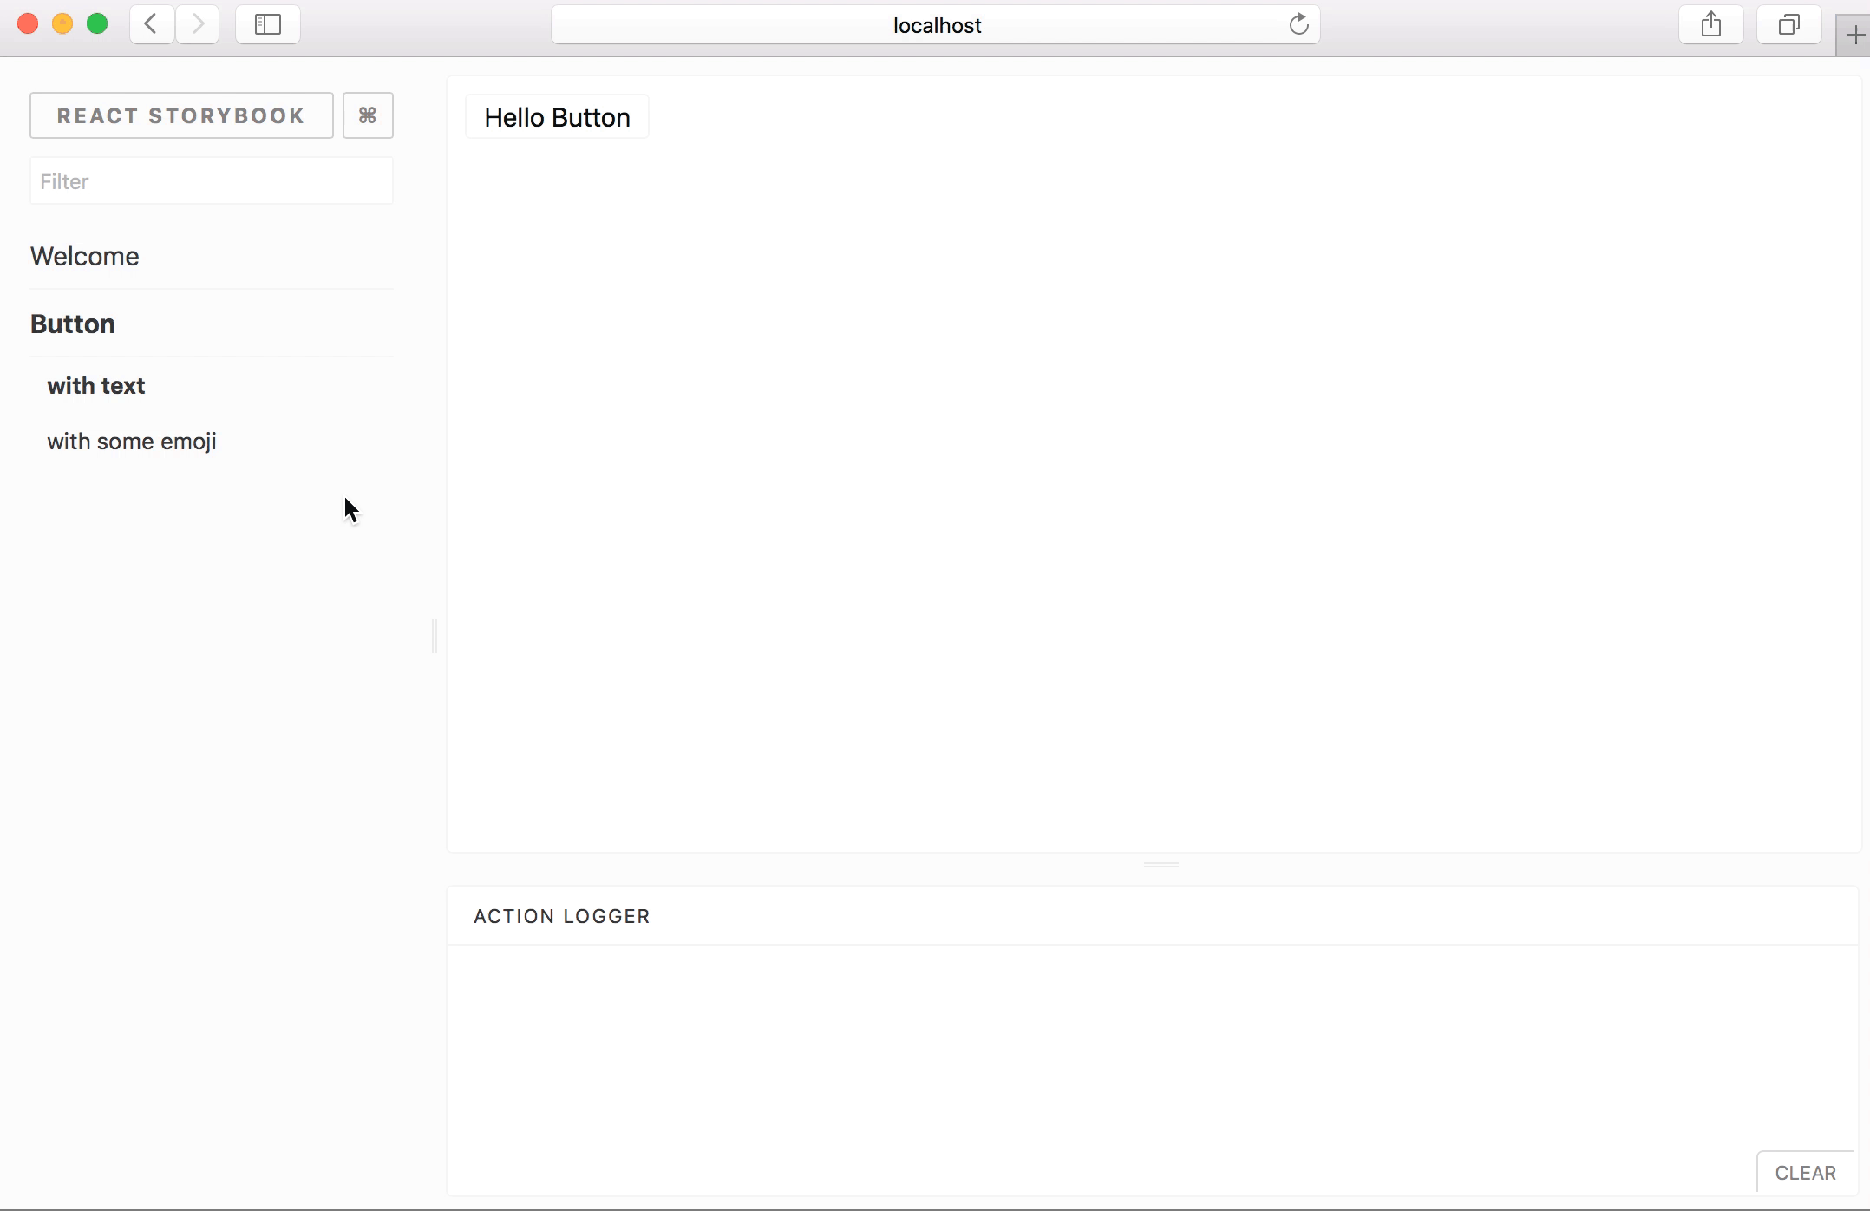

Slide 36
React Storybook React Cosmos Carte Blanche Compositor Lab, Electrode Explorer Chromatic Bluekit
Vue
Vue-play
Storybook
Angular
UI Storybook
Playground
Ember
Ember Freestyle

Slide 37
ISOLATED
INTERACTIVE
INDEPENDENT

Slide 38
+ Your testing suite

Slide 39
Very pretty.
But how do I do all of this…?

Slide 40
A.L.X

Slide 41

Alex Cejudo
Chief Design Officer @ Influencity

Slide 42

Alex Cejudo
Chief Design Officer @ Influencity
Component King

Slide 43
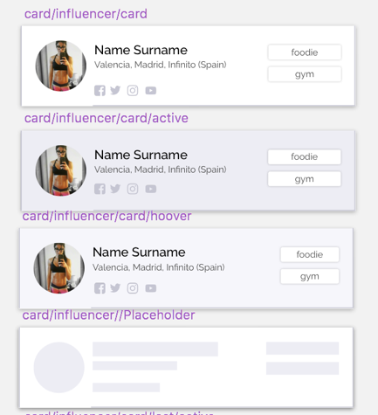
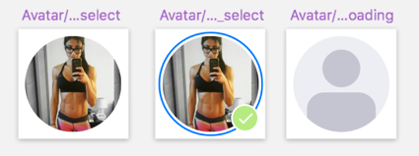

Slide 44
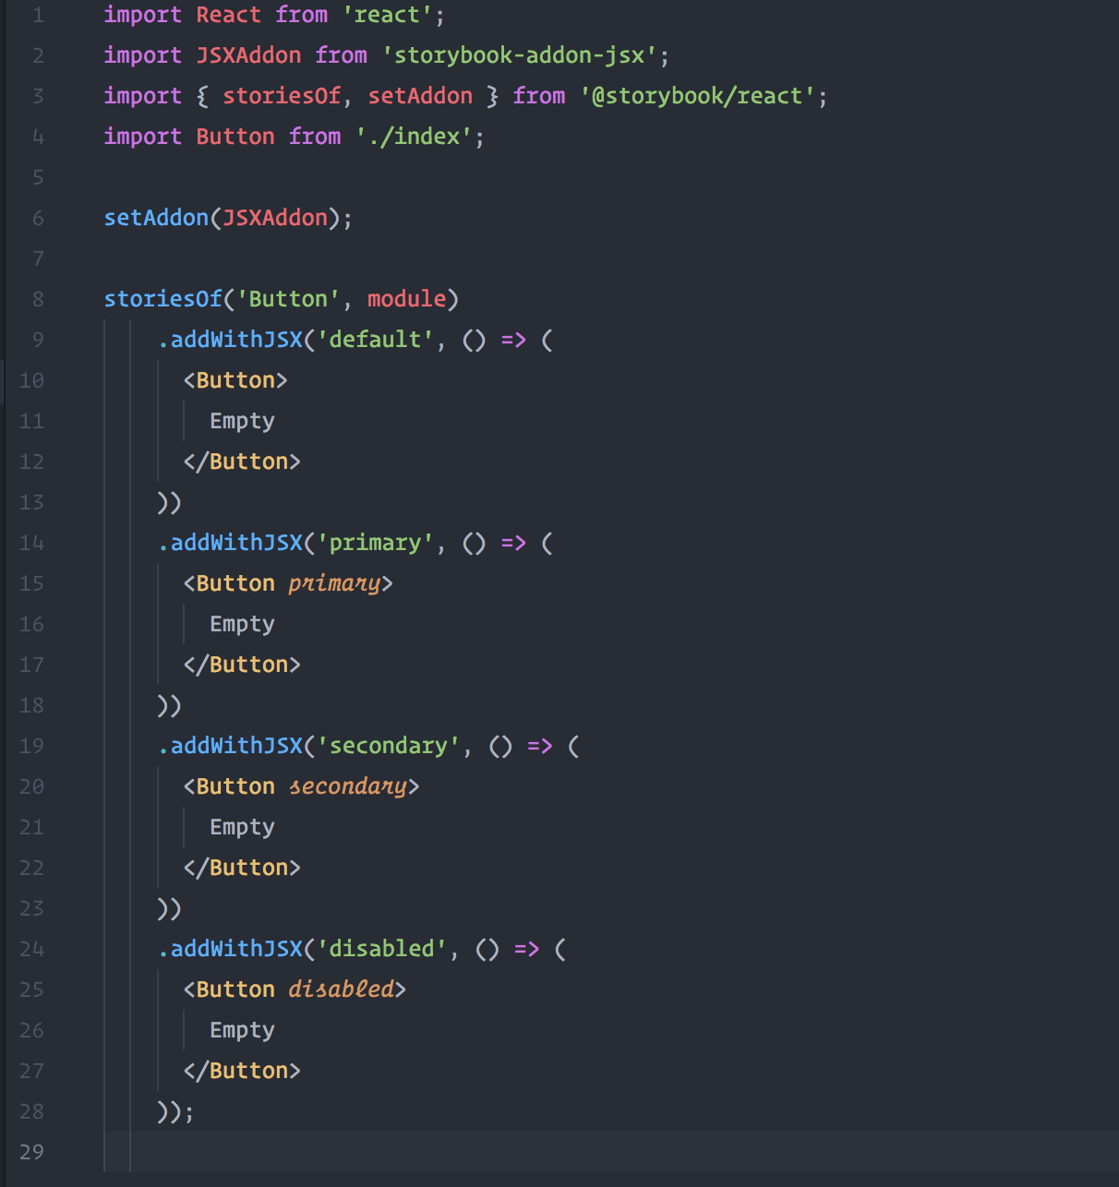

Slide 45
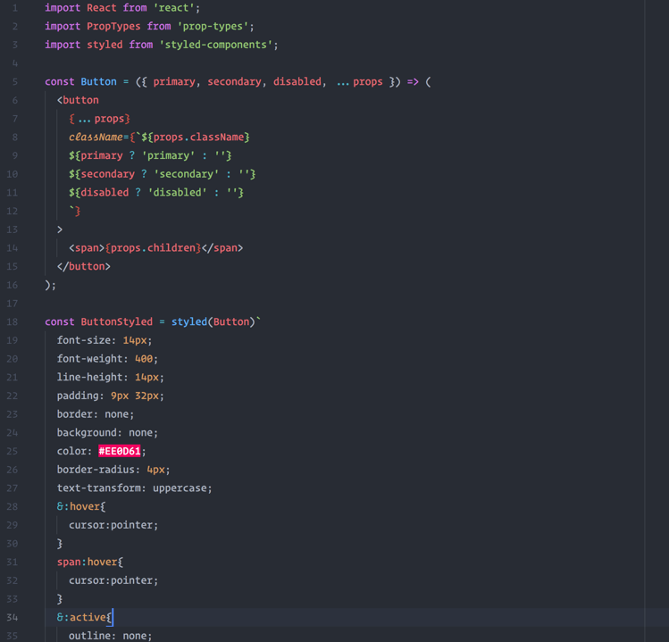

Slide 46
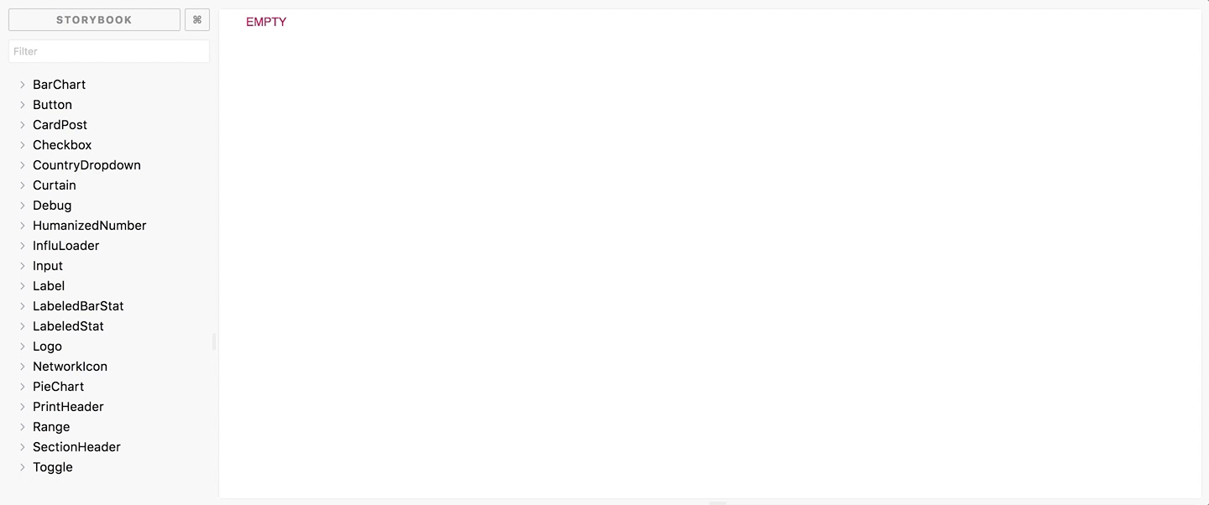

Slide 47
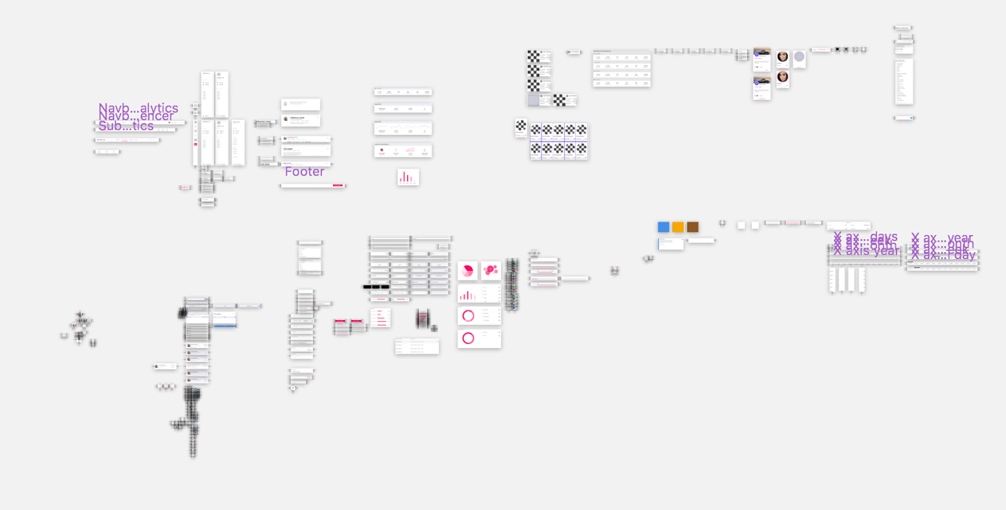

Slide 48
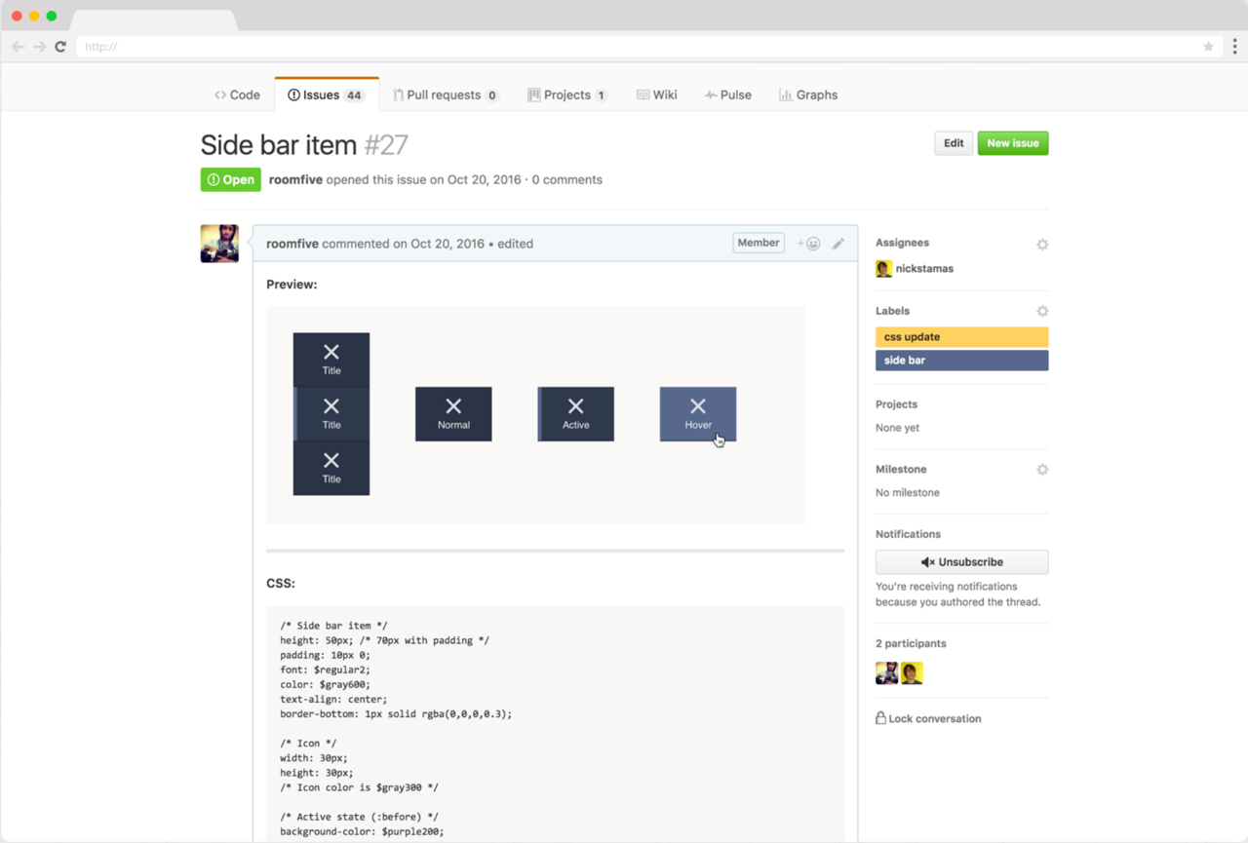
http://bit.ly/PlasmaDesign
Notes:
http://bit.ly/PlasmaDesign

Slide 49
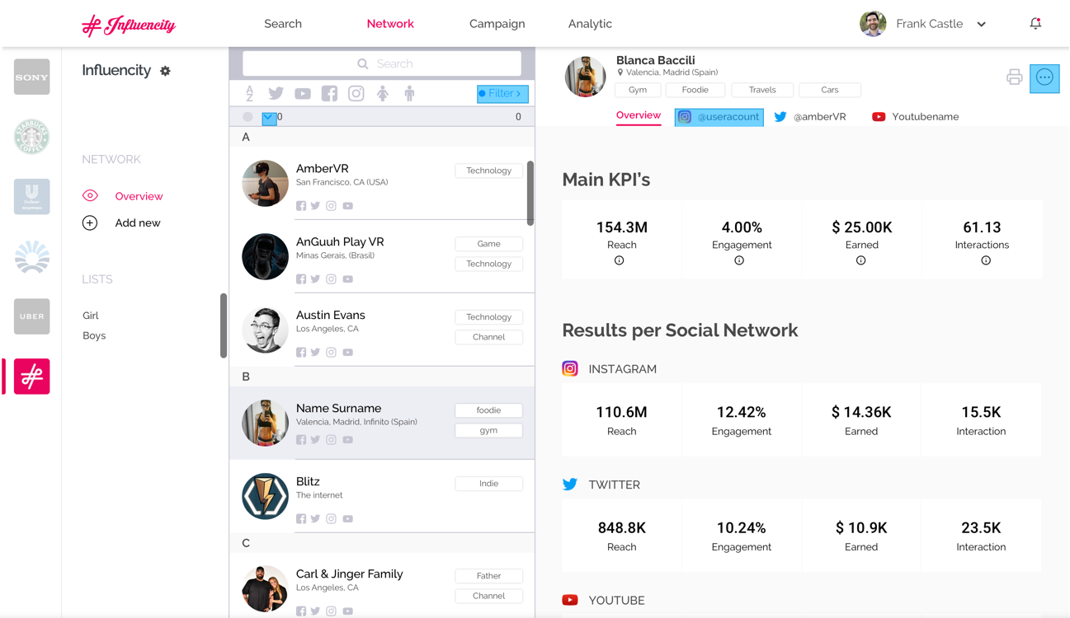

Slide 50
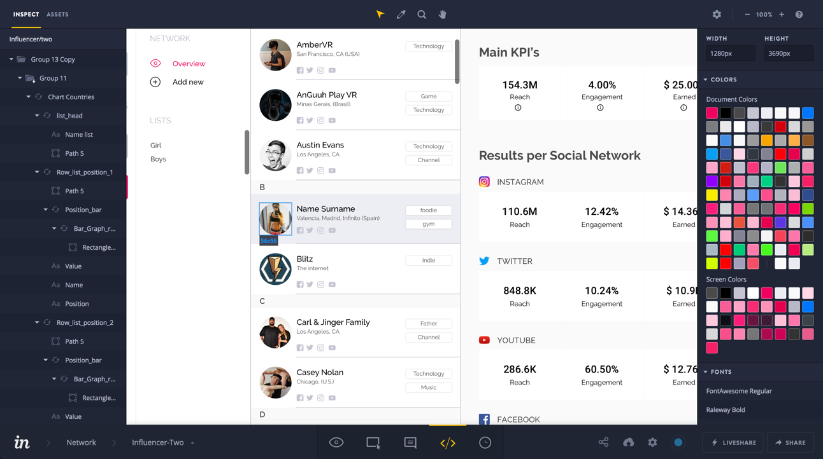

Slide 51


Conclusion
COMPONENTS + VDD =
More Usable
More Maintainable
Favours Reuse
Easier to Share
Less Code!
Peace of mind & SPEED

Slide 52

https://blog.hichroma.com

Slide 53

Alberto Villar (Vilva)
avillar@influencity.com | albertovilva.com | @albertovilva

Slide 54

EXAMPLES
& ??????
Notes:
React StoryBook - http://airbnb.io/react-dates/
Style Guide - https://www.lightningdesignsystem.com/components/breadcrumbs
Design System - https://medium.com/@andrewcouldwell/plasma-design-system-4d63fb6c1afc

